Slide 1
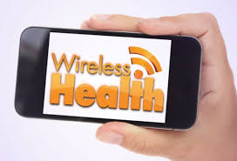

Slide 2
Introduction
Wireless communication in the world has facilitated very advanced programs that can be used to achieve the very best and qualitative goals. Therefore, when we talk about communication we just mention one of the many things that have been innovated in modern technology to be used in various perspectives.
The modernization of various domains has moved from infrastructure, communication, classroom perspectives, and even medical wise not forgetting the factories and even the industries. In this case of health, we understand that if the report of the person to be treated is readily available and at hand ready for giving the information then it means that this reliable report will be used at healthcare services for effective treatment of the patient

Slide 3
Introduction
When we talk of wireless health then we see that the patient will be monitored in a mobile way without difficulty. This implies that a digital way of treatment is always achieved depending on the management of the healthcare service this means that regardless of the physical place that one is located, healthcare services shall still go on. Below is a slide discussion on wireless healthcare.

Slide 4
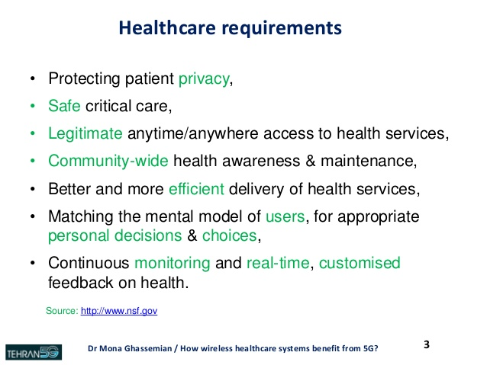
How Wireless Healthcare Systems benefit from 5G

Slide 5
Definition of wireless health
Wireless health is the use of an electronic device that monitors your health even in the absence of a doctor.
Let us for instance take the case of a sick person who is too old to take himself to the hospital, it is very difficult for this individual to be able to know what, how, and when he is supposed to take his medication and as a result, this person needs to be monitored to be able to get the best treatment that he deserves.

Slide 6
Definition of wireless health
Electrocardiography for example can be used to record the cardiac rate of a person. Some of these electronic devices are mostly used in sports to record the various events and even the drug use of a person.
Wrist monitors for example use optical sensors to check the rate of the heartbeat. For one to get a variety of information, this person needs to use the electrocardiography. This is because only measuring the heartbeat rate will give limited information.

Slide 7
Definition of wireless health
It is always good to consider external factors whenever one is monitoring someone. These factors may include temperature, heat, mood, health, and other parameters such as the pressure and the altitude sensors of a person.

Slide 8
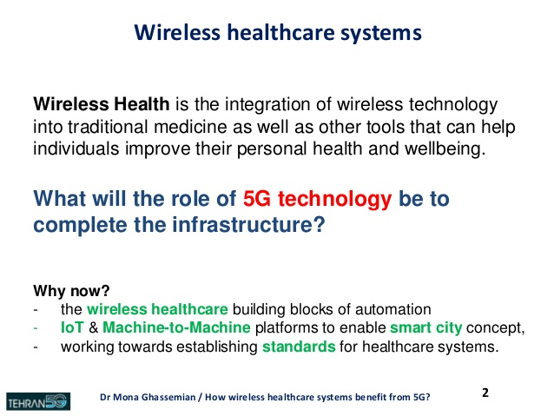

Slide 9
Wireless communication
For one to carry out mobile healthcare monitoring services, one needs to be sure of the wireless devices to use. This will assure the work being done and facilitate the treatment process. therefore if one wants to avoid the problem or challenges involving the wireless device, he or she should choose the device wisely and consider it workable.

Slide 10

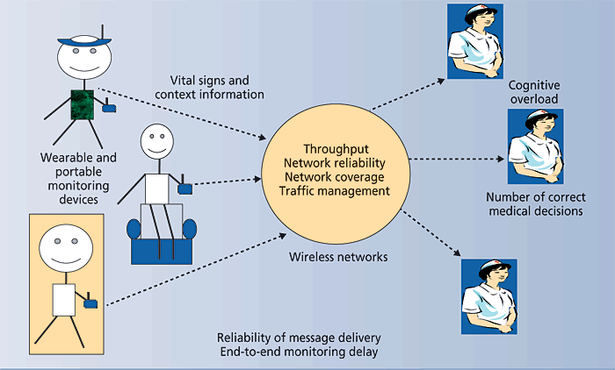

Slide 11
The block diagram of the monitoring system
These are as follows according to Smerdyznski, Pozoga (2014)
a. Monitoring user’s heart rate
b. Tracking user’s activities and defining positions
c. Fall detection
d. Monitoring one’s environmental conditions
e. Informing the use and their supervisors on the occurring irregularities and dangerous situation

Slide 12
The block diagram of the monitoring system
The monitoring user is connected to the sensor and Bluetooth low energy used for communication and collecting data from the sensor. Users' heart rate is monitored using the AFE circuit. In the theory, Smith (2011) our test proves that BLE can be used successfully in building with a range up to 30 meters with a small obstacle density on the radio system path.

Slide 13
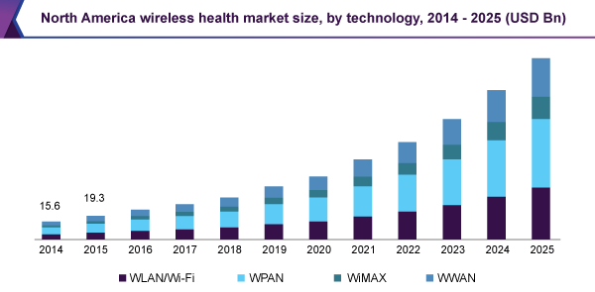
Wireless Health Market Size, Share & Trends Analysis Report By Technology

Slide 14
Monitoring system prototype
This one contains the very important elements that are used in the monitoring system. The microcontroller communicates with the supervising station.
The input signal was highly noisy in the filtrated signal and therefore it can be seen in the filtrated signal. Thanks to integration that the noise doesn’t interfere with the output signal. The wireless health monitoring system is monitored with a digital accelerator to make the follow-ups of all the activities of the user and the user himself.

Slide 15
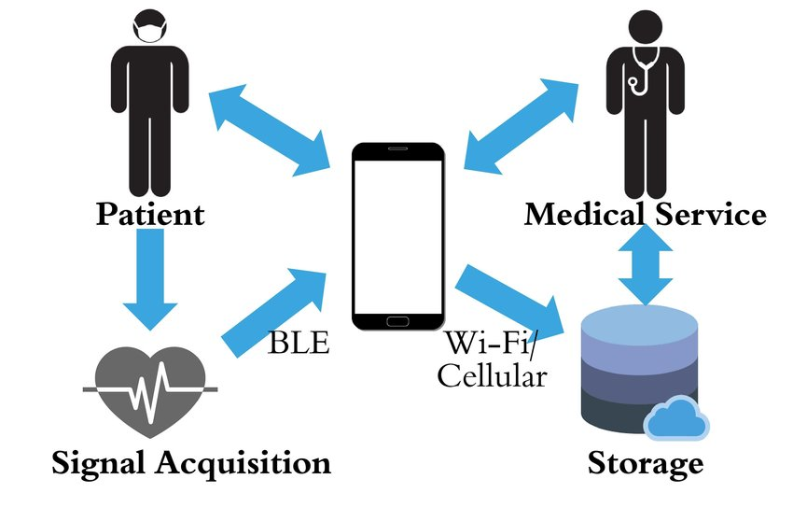
Wireless health monitoring system structure

Slide 16
Monitoring system prototype
The environmental condition is an added feature in the monitoring process.
The altitude sensor helps to locate someone hence used in periodic communication. The Bluetooth low energy is another unique and mostly used as the common protocol because the smartphones use BLE and have great parameters at a shorter range.

Slide 17
CONCLUSION
In the work above, we have seen that the wireless monitoring system is a very important device.
We have looked at its work and how it is used and can be used to safeguard the health of individuals without a doctor or clinician who needs to be around to ensure their safety. As of now, the elderly are the most vulnerable people in society at large. Therefore, it is so that these devices, monitoring them should be put in place so that to ensure their wellbeing.

Slide 18
CONCLUSION
The person's health will be followed and ensured that they are offered mobile treatment as prescribed. In these, we are told that the only thing that the monitoring person needs is to install the application of Bluetooth in a smartphone. Therefore, the system is in the process of innovation and development so that it can be installed to the user and start functioning.

Slide 19
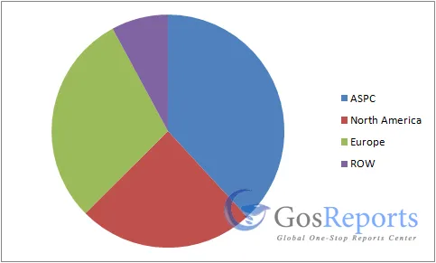
GLOBAL WIRELESS HEALTH MARKET TO REACH USD$ 115 BILLION BY 2021

Slide 20
Ahlberg, L. Off the Shelf, on the Skin: Stick-on Electronic Patches for Health Monitoring. 2014.
Wcislik, M., Pozoga, M., & Smerdzynski, P. (2015). Wireless health monitoring system. IFAC-PapersOnLine, 48(4), 312-317.

